Slide 1


Slide 2
Mathematical Foundation For Machine Learning
Dr. Umesh P

Slide 3

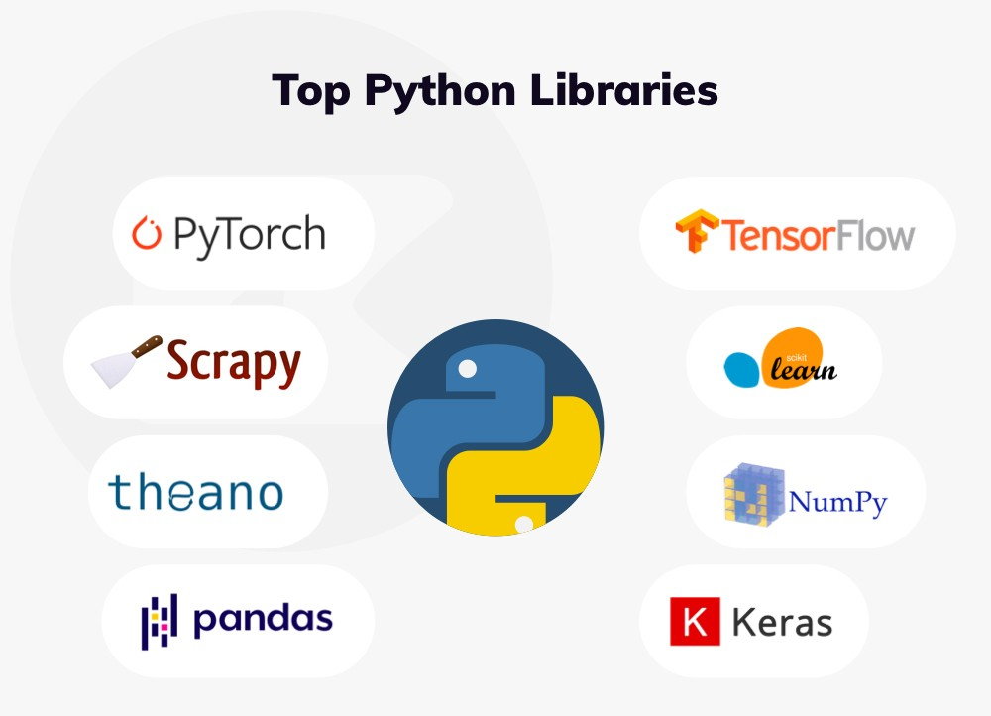
Machine Learning >
images used are for academic purpose. Copyright to original author

Slide 4
But people create…
from numpy import loadtxt
from keras.models import Sequential
from keras.layers import Dense
model = Sequential()
model.add(Dense(12, input_dim=8, activation='relu'))
model.add(Dense(8, activation='relu'))
model.add(Dense(1, activation='sigmoid'))
model.compile(loss='binary_crossentropy', optimizer='adam', metrics=['accuracy'])
model.fit(X, y, epochs=150, batch_size=10)

Slide 5
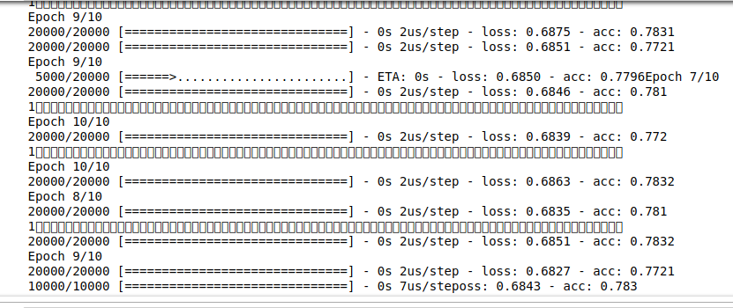
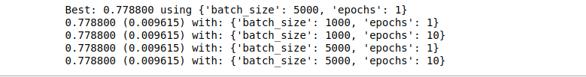
BLAA BLA BLAA

Slide 6

The ML black box
images used are for academic purpose. Copyright to original author

Slide 7
MATH IN LEARNING <= MACHINE LEARNING

Slide 8



Slide 9
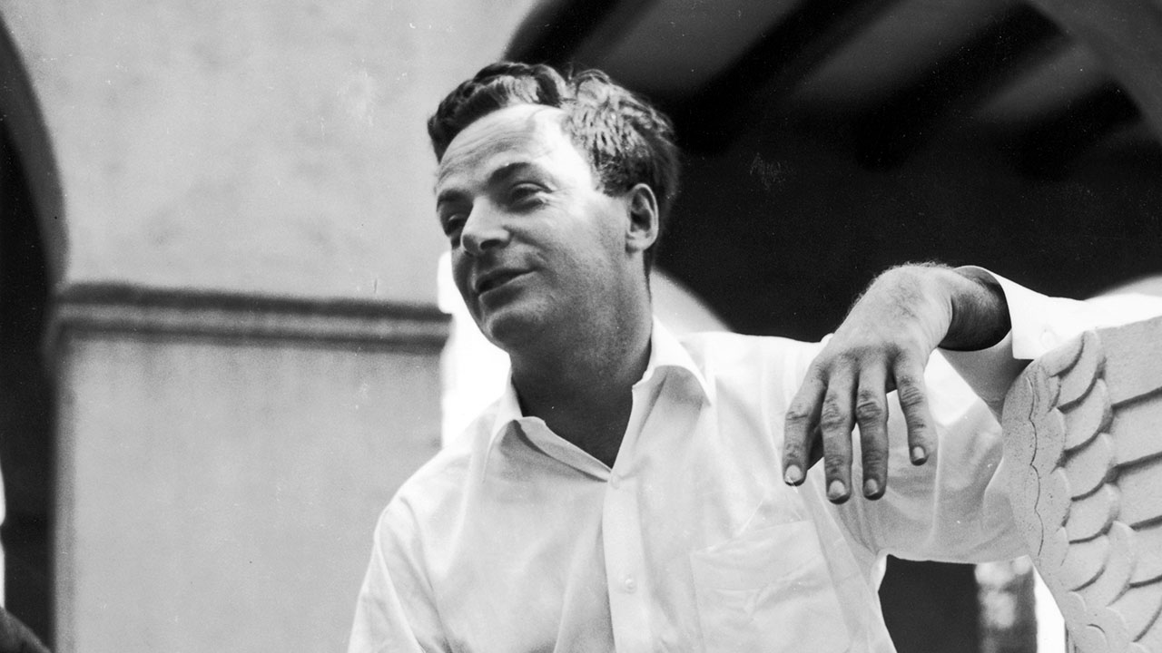
What I cannot create, I do not understand
images used are for academic purpose. Copyright to original author

Slide 10
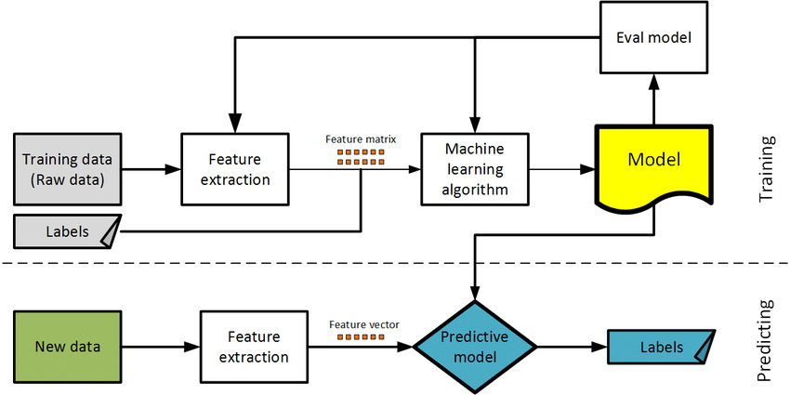
A Bird Eye View

Slide 11
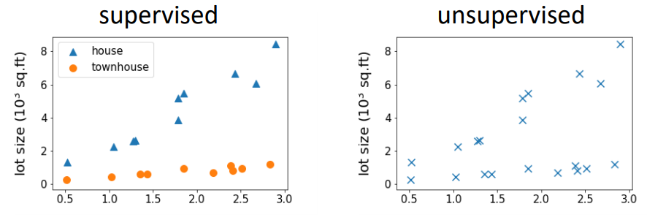
A Bird Eye View

Slide 12
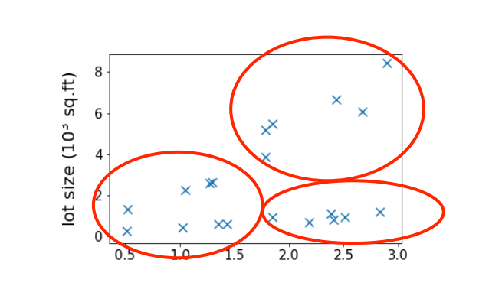
A Bird Eye View

Slide 13
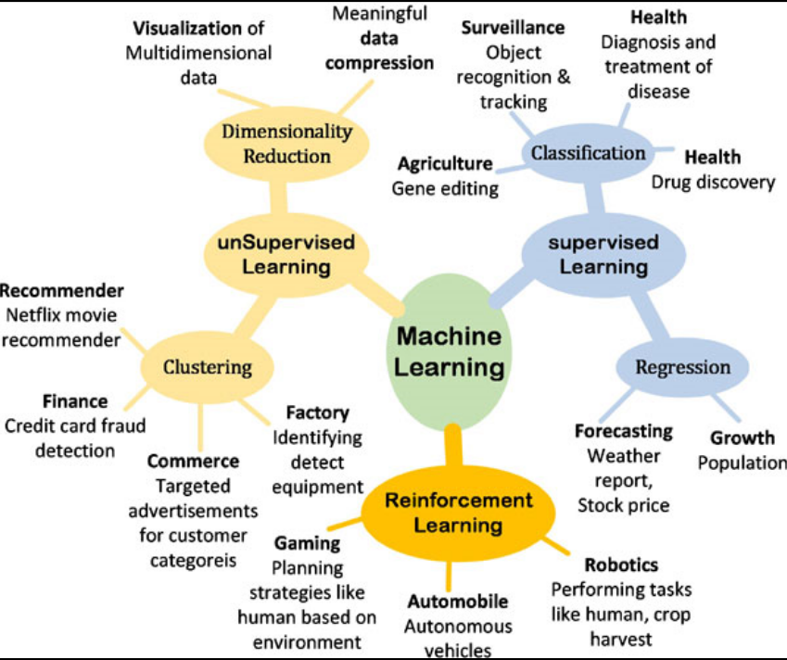

Slide 14

Why MATH?
How do you Select the right algorithm ?
How do you Choose parameter settings and validation strategies?
How do you Identify under fitting and over fitting and understand the Bias-Variance tradeoff?
How do you Estimate the right confidence interval and uncertainty?

Slide 15

How Much MATH is needed?
images used are for academic purpose. Copyright to original author

Slide 16
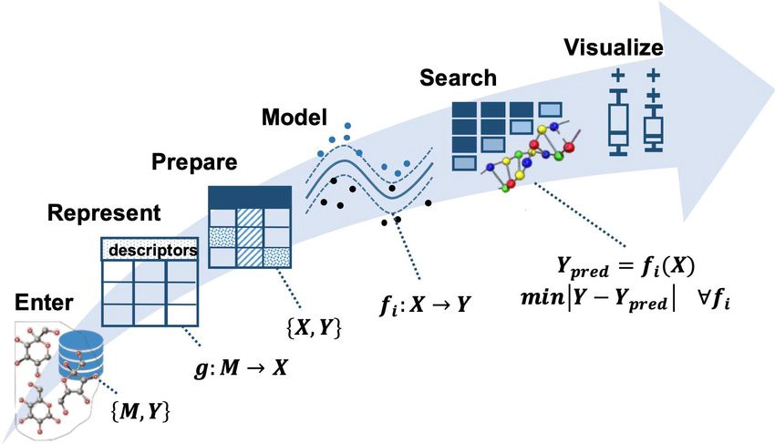
ML is written in Mathematics… Learn the Language ….
images used are for academic purpose. Copyright to original author

Slide 17
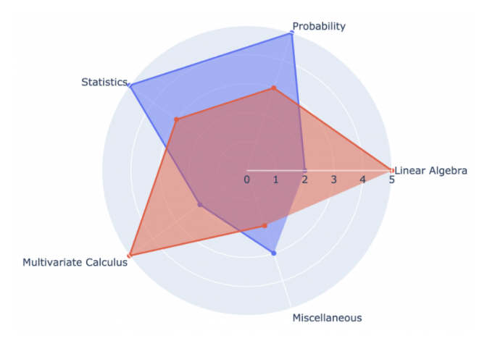
Data Science
ML
images used are for academic purpose. Copyright to original author

Slide 18
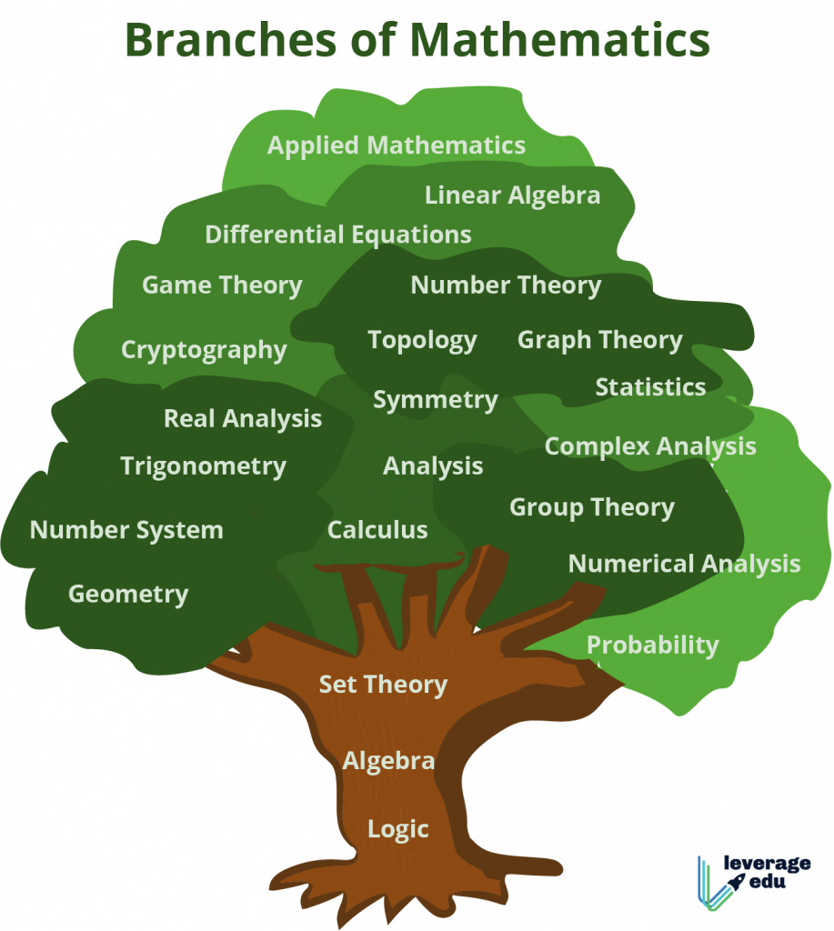
images used are for academic purpose. Copyright to original author

Slide 20
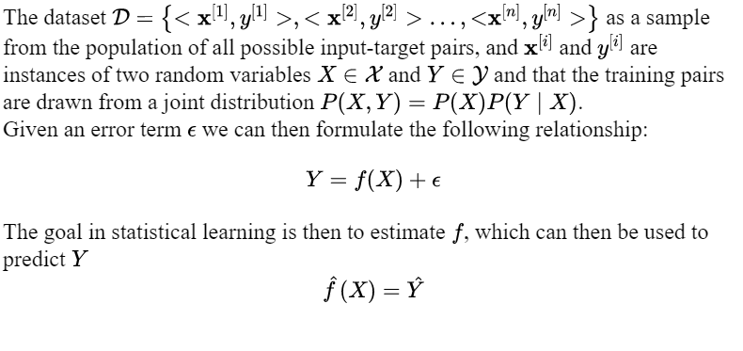

Slide 21
Linear Algebra
A Gentle overview
LA and ML
ICFOSS
21
Notes:
21

Slide 22
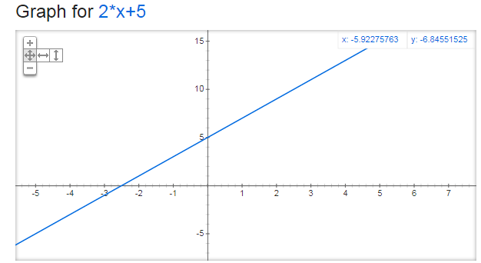
What does these mean graphically (up to 3D)
Linear Algebra-A Gentle overview

Slide 23
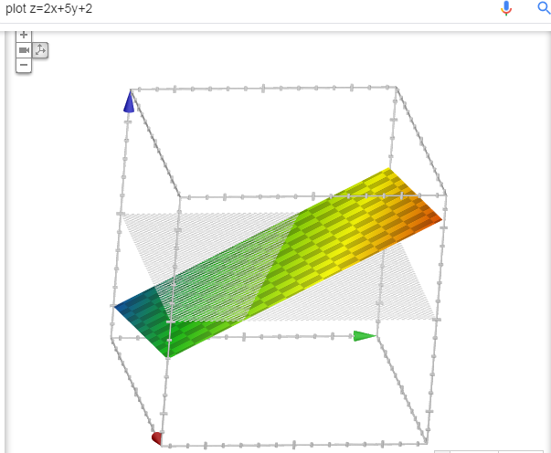
Linear equations
Linear Algebra-A Gentle overview

Slide 24
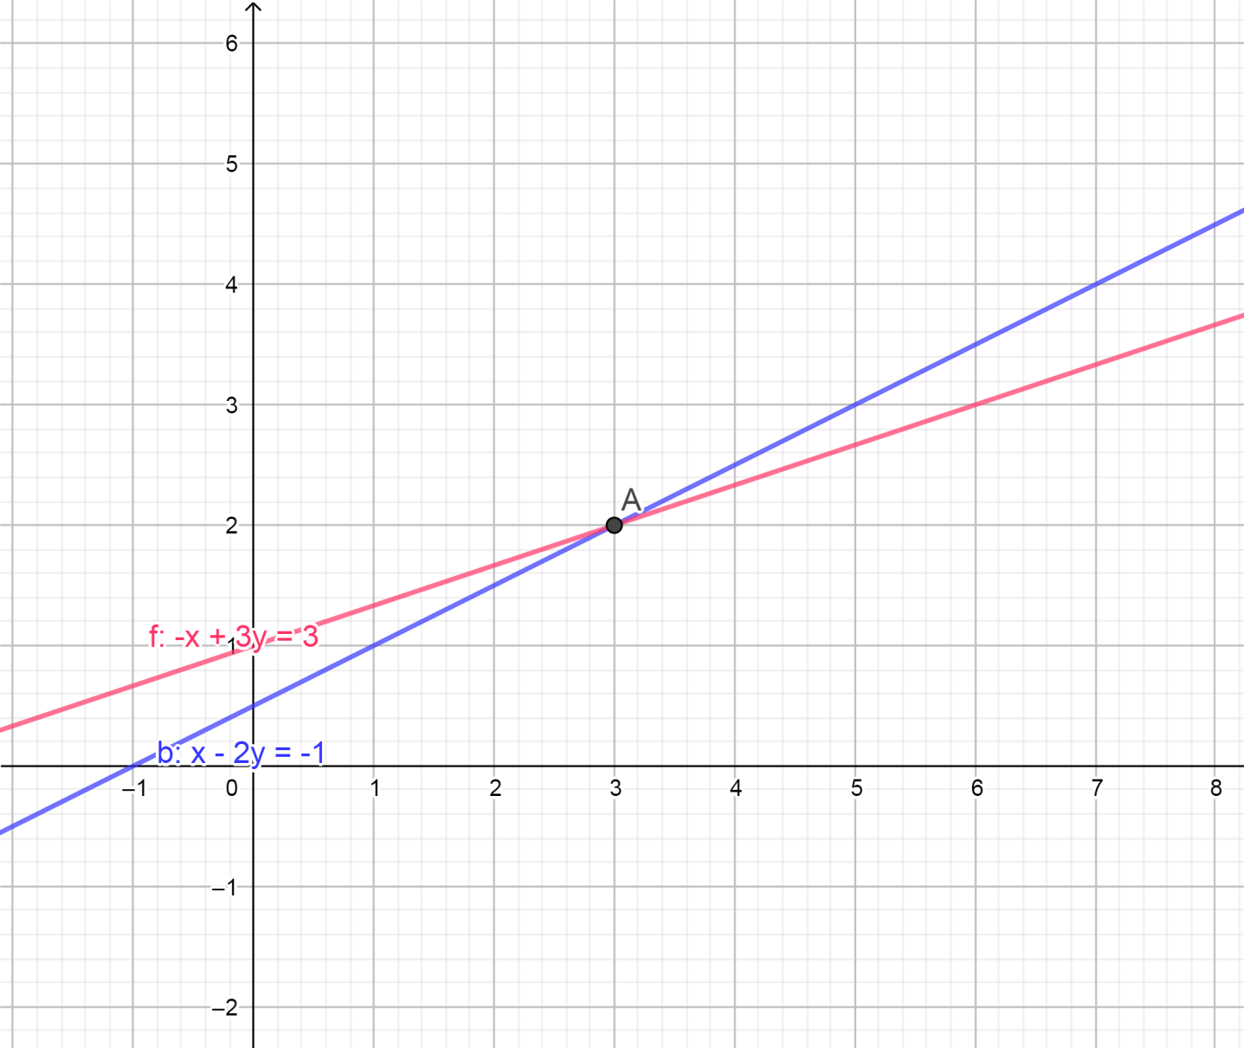
System of Linear equations
Linear Algebra-A Gentle overview

Slide 25
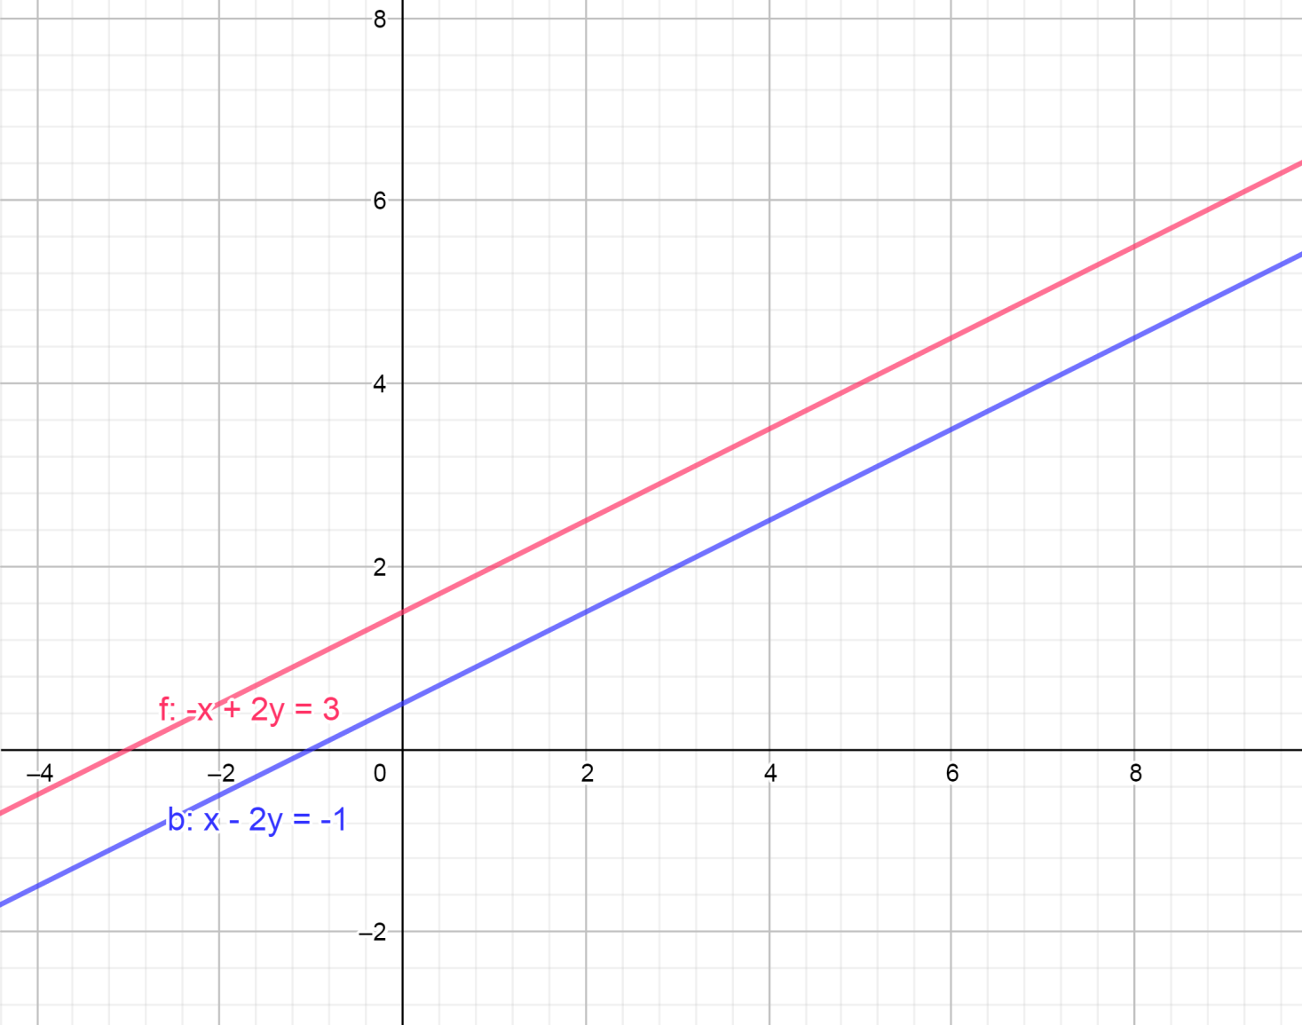
Linear Algebra-A Gentle overview

Slide 26
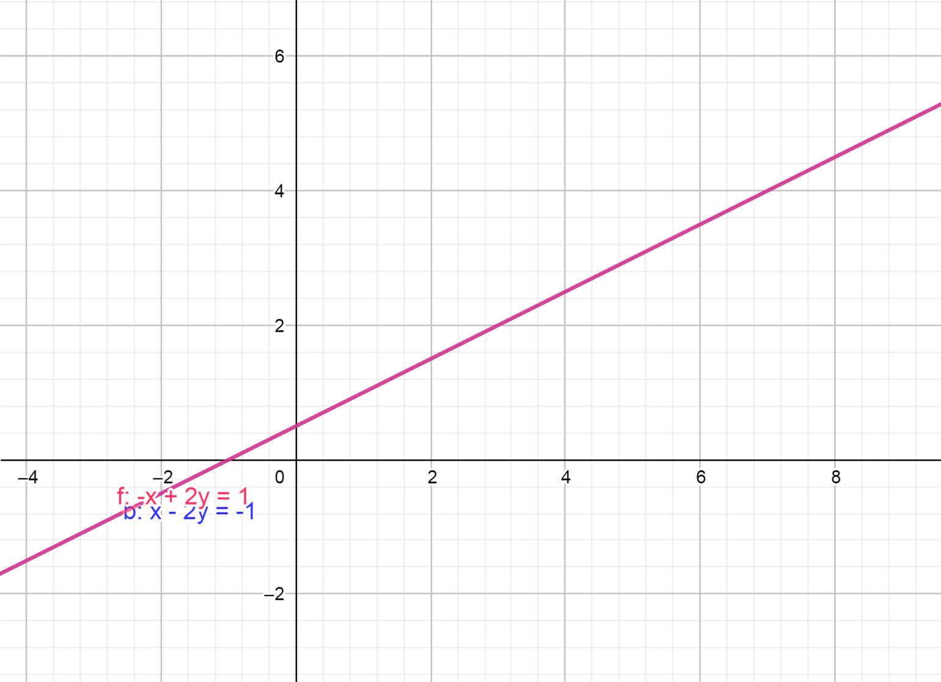
Linear Algebra-A Gentle overview

Slide 27
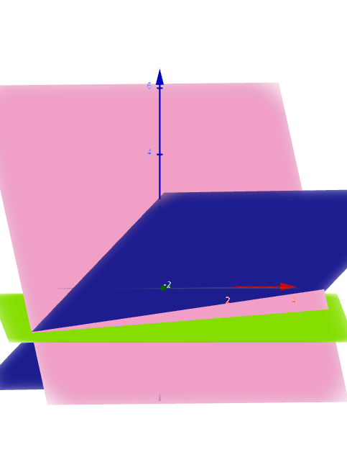
Linear Algebra-A Gentle overview

Slide 28
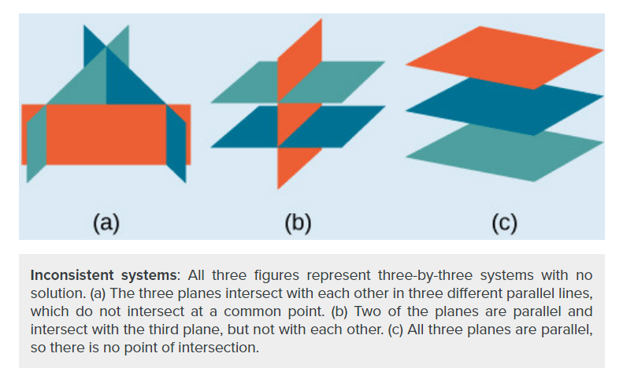
Linear Algebra-A Gentle overview
https://courses.lumenlearning.com/boundless-algebra/chapter/systems-of-equations-in-three-variables/
images used are for academic purpose. Copyright to original author

Slide 29
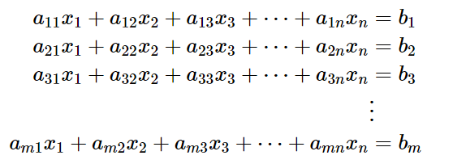
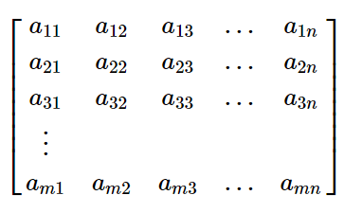
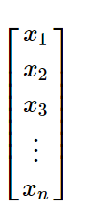
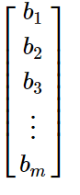
Linear Algebra-A Gentle overview
=

Slide 30
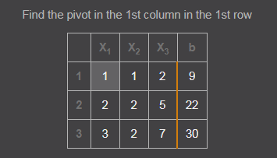
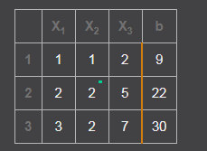
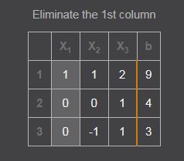
Matrices to solve the system
Linear Algebra-A Gentle overview

Slide 31
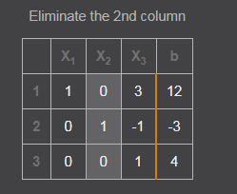
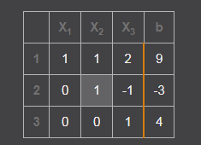
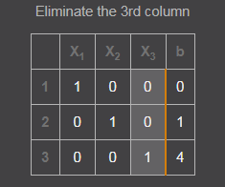
Linear Algebra-A Gentle overview
x = 0
y = 1
z = 4

Slide 32
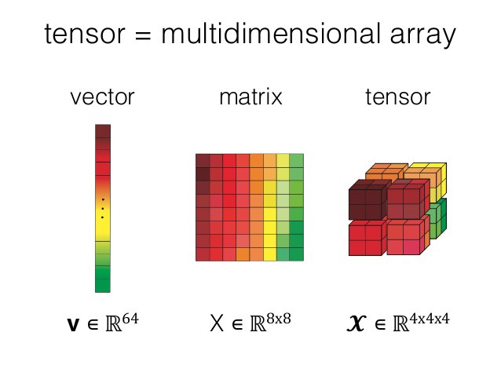
Linear Algebra-A Gentle overview
images used are for academic purpose. Copyright to original author

Slide 33
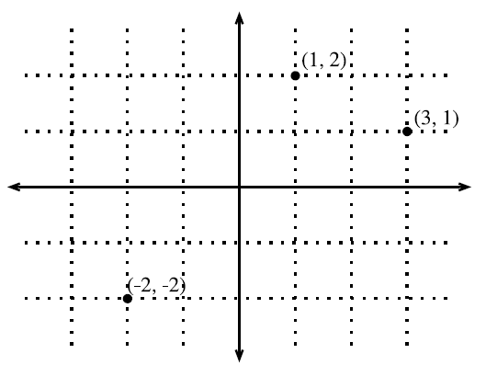
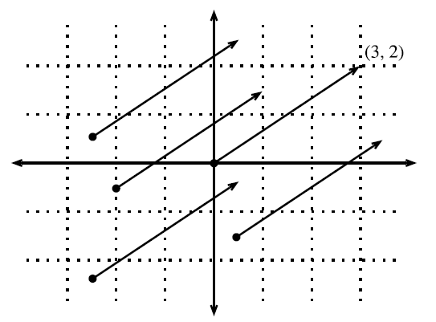
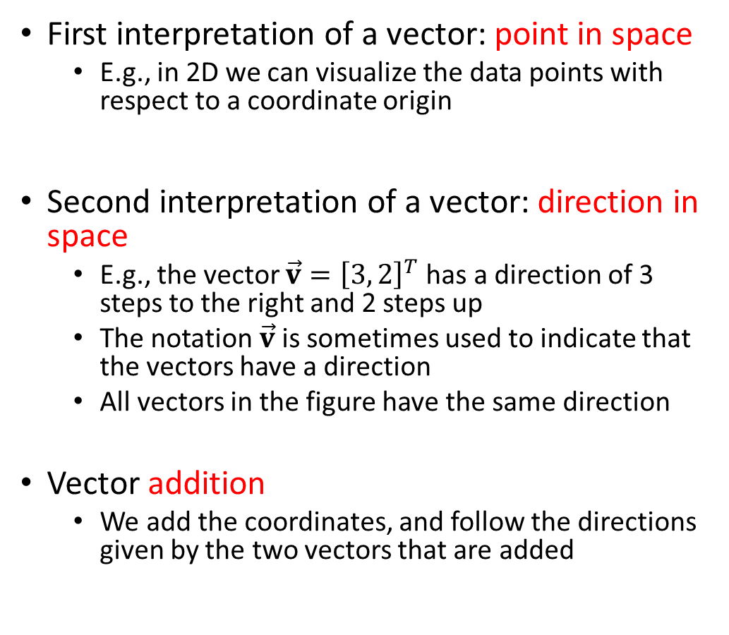
Geometry of Vectors
First interpretation of a vector: point in space
E.g., in 2D we can visualize the data points with respect to a coordinate origin
Second interpretation of a vector: direction in space
E.g., the vector $\vec{v}={\left[3, 2\right]}^{T}$ has a direction of 3 steps to the right and 2 steps up
The notation $\vec{v}$ is sometimes used to indicate that the vectors have a direction
All vectors in the figure have the same direction
Vector addition
We add the coordinates, and follow the directions given by the two vectors that are added

Slide 34
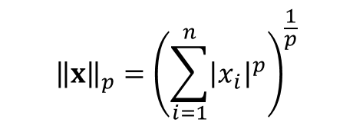
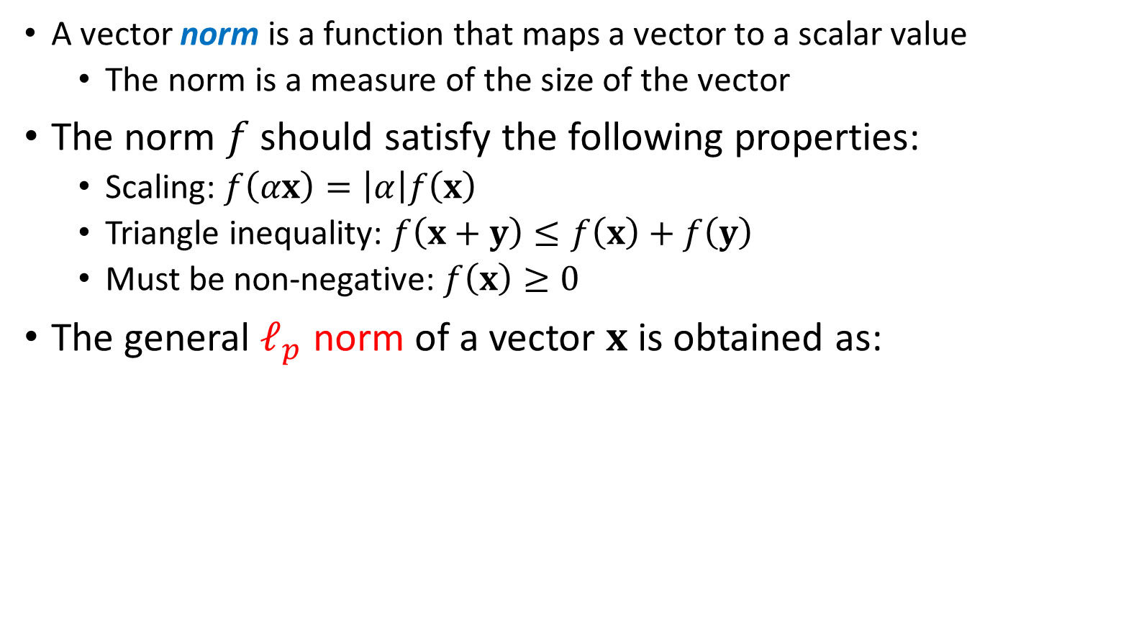
Norm of a Vector
A vector norm is a function that maps a vector to a scalar value
The norm is a measure of the size of the vector
The norm $f$ should satisfy the following properties:
Scaling: $f\left(αx\right)=\left|α\right|f\left(x\right)$
Triangle inequality: $f\left(x+y\right)≤f\left(x\right)+f\left(y\right)$
Must be non-negative: $f\left(x\right)≥0$
The general $ℓ_{p}$ norm of a vector $x$ is obtained as:
$${\left\|x\right\|}_{p}={\left(\sum_{i=1}^{n}{{\left|x_{i}\right|}^{p}}\right)}^{\frac{1}{p}}$$

Slide 35
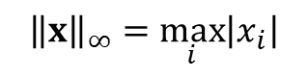
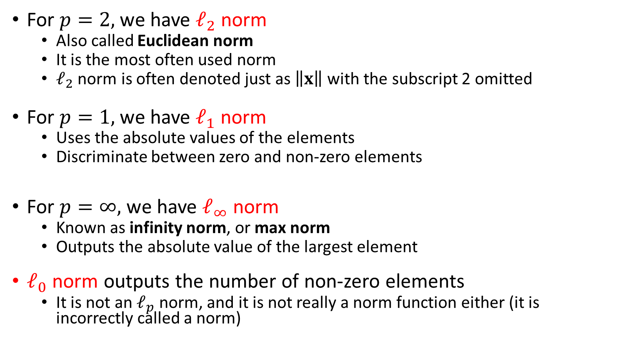
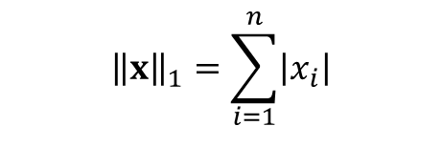
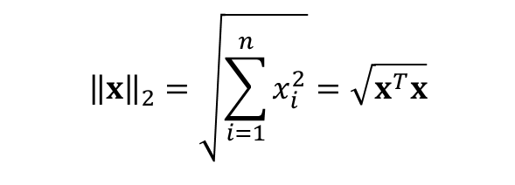
$${\left\|x\right\|}_{2}=\sqrt{\sum_{i=1}^{n}{x_{i}^{2}}}=\sqrt{x^{T}x}$$
For $p=2,$we have $ℓ_{2}$ norm
Also called Euclidean norm
It is the most often used norm
$ℓ_{2}$ norm is often denoted just as $\left\|x\right\|$ with the subscript 2 omitted
For $p=1,$we have $ℓ_{1}$ norm
Uses the absolute values of the elements
Discriminate between zero and non-zero elements
For $p=∞,$we have $ℓ_{∞}$ norm
Known as infinity norm, or max norm
Outputs the absolute value of the largest element
$ℓ_{0}$ norm outputs the number of non-zero elements
It is not an $ℓ_{p}$ norm, and it is not really a norm function either (it is incorrectly called a norm)
$${\left\|x\right\|}_{1}=\sum_{i=1}^{n}{\left|x_{i}\right|}$$
$${\left\|x\right\|}_{∞}=\max_{i}\left|x_{i}\right|$$

Slide 36
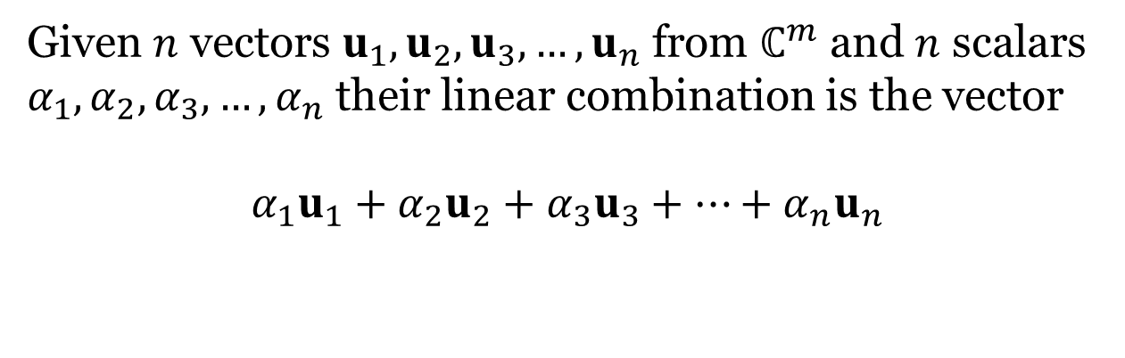
Linear Independence & Basis
Linear Algebra-A Gentle overview
Given $n$ vectors $u_{1},u_{2},u_{3},…,u_{n}$ from $ℂ^{m}$ and $n$ scalars
$α_{1},α_{2},α_{3},…,α_{n}$ their linear combination is the vector
$$α_{1}u_{1}+α_{2}u_{2}+α_{3}u_{3}+⋯+α_{n}u_{n}$$

Slide 37
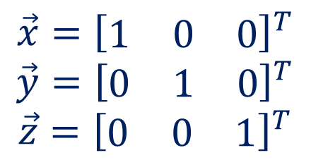
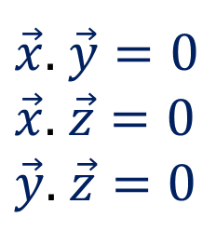
Basis & Orthonormal Bases
Linear Algebra-A Gentle overview
Basis: a space is totally defined by a set of vectors – any vector is a linear combination of the basis
Ortho-Normal: orthogonal + normal
[Orthogonal: dot product is zero
Normal: magnitude is one ]

Slide 38
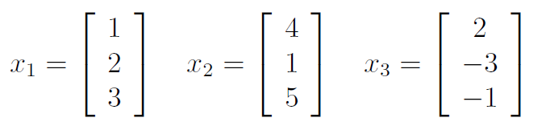
Linear independence
Linear Algebra-A Gentle overview
A set of vectors is linearly independent if none of them can be written as a linear combination of the others.
Vectors v₁,…,v_{k} are linearly independent if c₁v₁+…+c_{k}v_{k} = 0 implies c₁=…=c_{k}=0
e.g.
(u,v)=(0,0), i.e. the columns are linearly independent.
x3 = −2x1 + x2

Slide 39
Span
Linear Algebra-A Gentle overview
If all vectors in a vector space may be expressed as linear combinations of a set of vectors v₁,…,v_{k}, then v₁,…,v_{k} spans the space.
The cardinality of this set is the dimension of the vector space.
A basis is a maximal set of linearly independent vectors and a minimal set of spanning vectors of a vector space
e.g.
(0,0,1)
(0,1,0)
(1,0,0)

Slide 40
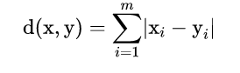
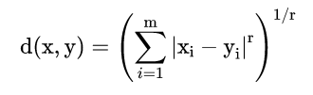
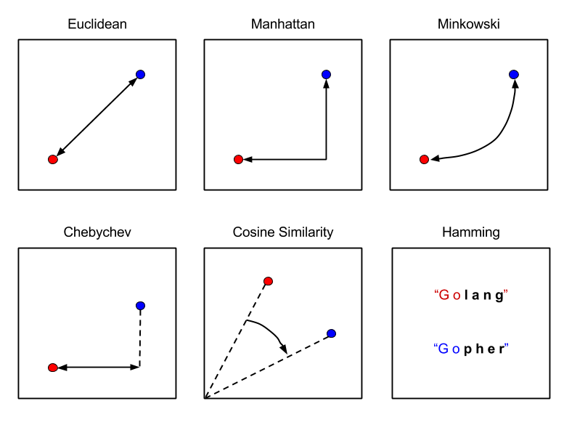
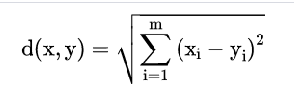
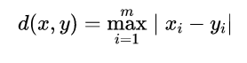
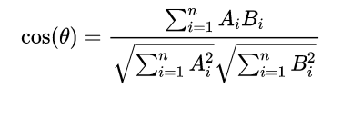
Linear Algebra-A Gentle overview
images used are for academic purpose. Copyright to original author

Slide 41
Euclidean Distance-shortest distance between two points.
Manhattan Distance -sum of absolute differences between points across all the dimensions.
Minkowski Distance - generalized form of Euclidean and Manhattan Distance
Hamming Distance - similarity between two strings of the same length

Slide 42
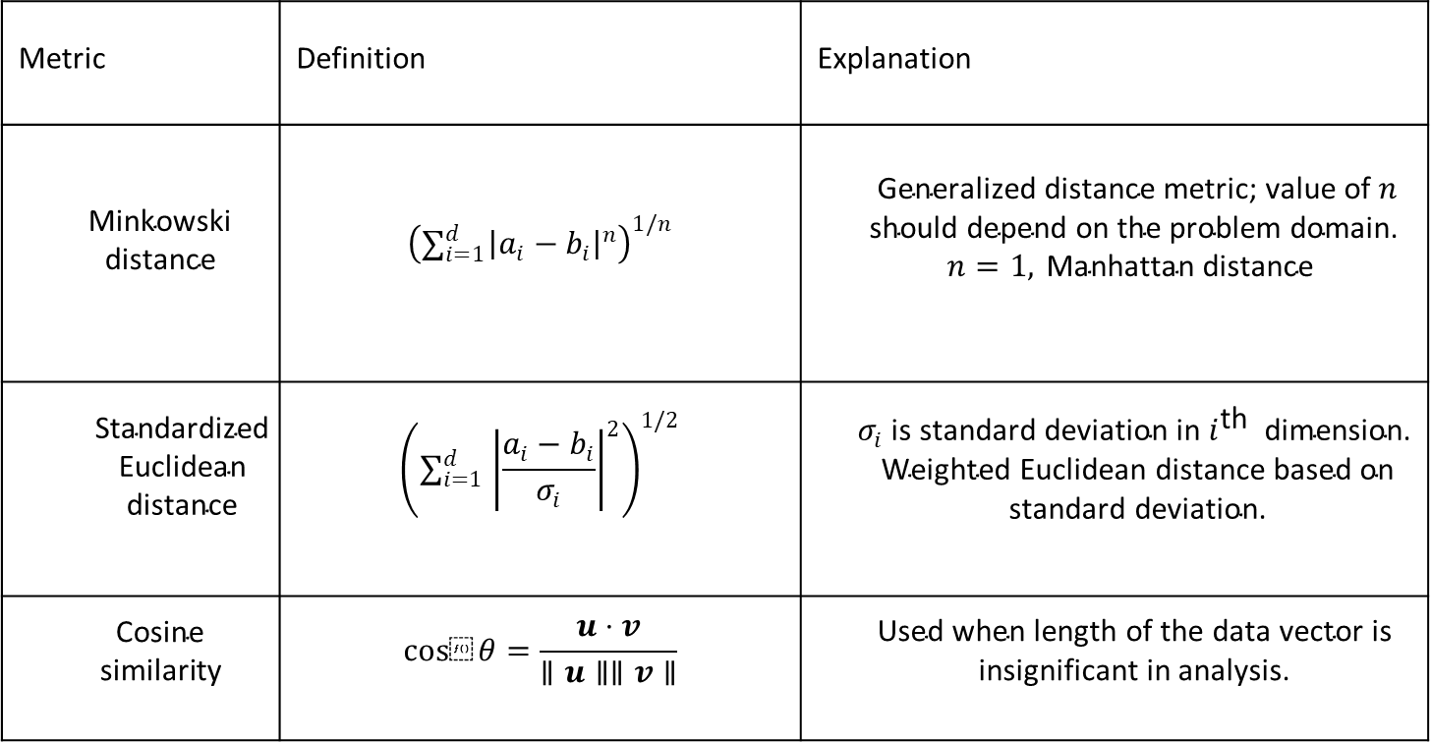
Metric | Definition | Explanation
$$\begin{matrix} & \text{Minkowski} \\ & \text{distance} \end{matrix}$$ | $${\left(∑_{i=1}^{d} {\left|a_{i}−b_{i}\right|}^{n}\right)}^{1/n}$$ | $$\begin{matrix} & \text{Generalized} \text{distance} \text{metric}\text{; }\text{value} \text{of} n \\ & \text{should} \text{depend} \text{on} \text{the} \text{problem} \text{domain}\text{. } \\ & n=1, \text{Manhattan} \text{distance} \end{matrix}$$
$$\begin{matrix} & \text{Standardized} \\ & \text{Euclidean} \\ & \text{distance} \end{matrix}$$ | $${\left(∑_{i=1}^{d} {\left|\frac{a_{i}−b_{i}}{σ_{i}}\right|}^{2}\right)}^{1/2}$$ | $$\begin{matrix} & σ_{i} \text{is} \text{standard} \text{deviation} \text{in} i^{\text{th} } \text{dimension}\text{. } \\ & \text{Weighted} \text{Euclidean} \text{distance} \text{based} \text{on} \\ & \text{standard} \text{deviation}\text{. }\end{matrix}$$
$$\begin{matrix} & \text{Cosine} \\ & \text{similarity} \end{matrix}$$ | $$cos⁡θ=\frac{u⋅v}{∥u∥∥v∥}$$ | $$\begin{matrix} & \text{Used} \text{when} \text{length} \text{of} \text{the} \text{data} \text{vector} \text{is} \\ & \text{insignificant} \text{in} \text{analysis}\text{. }\end{matrix}$$

Slide 43


Projection of a vector $y$ onto vector $x$
The projection can take place in any space of dimensionality ≥ 2
The unit vector in the direction of $x$ is $\frac{x}{\left\|x\right\|}$
A unit vector has norm equal to 1
The length of the projection of $y$ onto $x$is $\left\|y\right\|∙cos\left(θ\right)$
The orthogonal project is the vector${ proj}_{x}\left(y\right)$
$${proj}_{x}\left(y\right)=\frac{x∙\left\|y\right\|∙cos\left(θ\right)}{\left\|x\right\|}$$

Slide 44


Slide 45

Orthogonal Projection
Linear Algebra-A Gentle overview
Images used are for academic purposes. Copyright to the original author

Slide 46

Orthogonal Projection
Linear Algebra-A Gentle overview
Images used are for academic purposes. Copyright to the original author

Slide 47


Slide 48


Hyperplane is a subspace whose dimension is one less than that of its ambient space
In a 2D space, a hyperplane is a straight line (i.e., 1D)
In a 3D, a hyperplane is a plane (i.e., 2D)
In a d-dimensional vector space, a hyperplane has $d−1$ dimensions, and divides the space into two half-spaces
Hyperplane is a generalization of a concept of plane in high-dimensional space
In ML, hyperplanes are decision boundaries used for linear classification
Data points falling on either sides of the hyperplane are attributed to different classes

Slide 49

Vectors and matrices and transformation
Linear Algebra-A Gentle overview

Slide 50

Linear Algebra-A Gentle overview

Slide 51

Linear Algebra-A Gentle overview

Slide 52

Determinant
$$A=\left[\begin{matrix}1 & 2 \\ −1 & 3\end{matrix}\right]$$

Slide 53

Determinant
$$A=\left[\begin{matrix}1 & 2 \\ −1 & 3\end{matrix}\right]$$

Slide 54
Determinant
$$A=\left[\begin{matrix}1 & 2 \\ −1 & 3\end{matrix}\right]$$

Slide 55



`
Linear Algebra-A Gentle overview
$$\left(\begin{matrix}cos{θ} & sin{θ} \\ −sin{θ} & cos{θ}\end{matrix}\right)$$
Representing a clockwise rotation over angle θ
$$\left(\begin{matrix}0 & 1 \\ −1 & 0\end{matrix}\right)$$
90 degrees clockwise rotation
Scaling is defined by a diagonal matrix
$$\left(\begin{matrix}s_{1} & 0 \\ 0 & s_{2}\end{matrix}\right)$$

Slide 56


Eigen Values and Eigen vectors
Linear Algebra-A Gentle overview

Slide 57

Eigen Values and Eigen vectors
Linear Algebra-A Gentle overview
Eigen vector

Slide 58

Eigen Values and Eigen vectors
Linear Algebra-A Gentle overview
Eigen vector

Slide 59

Matrix Rank
For an $n×m$ matrix, the rank of the matrix is the largest number of linearly independent columns
The matrix B from the previous example has $rank\left(B\right)=1$, since the two columns are linearly dependent
The matrix C below has $rank\left(C\right)=2$, since it has two linearly independent columns
I.e., ${ c}_{4}=−1∙{ c}_{1}$, ${ c}_{5}=−1∙{ c}_{3}$, ${ c}_{2}=3∙{ c}_{1}$ $+3∙{ c}_{3}$
$$C=\left[\begin{matrix}1 & 3 \\ −1 & 0 \\ \begin{matrix}0 \\ 2\end{matrix} & \begin{matrix}−3 \\ 3\end{matrix}\end{matrix} \begin{matrix}0 & −1 & 0 \\ 1 & 1 & −1 \\ \begin{matrix}1 \\ −1\end{matrix} & \begin{matrix}0 \\ −2\end{matrix} & \begin{matrix}−1 \\ 1\end{matrix}\end{matrix}\right]$$

Slide 60


Eigen Decomposition
Geometric interpretation of the eigenvalues and eigenvectors is that they allow to stretch the space in specific directions
Left figure: the two eigenvectors $v^{1}$ and $v^{2}$are shown for a matrix, where the two vectors are unit vectors (i.e., they have a length of 1)
Right figure: the vectors $v^{1}$ and $v^{2}$ are multiplied with the eigenvalues $λ_{1}$ and $λ_{2}$
We can see how the space is scaled in the direction of the larger eigenvalue $λ_{1}$
E.g., this is used for dimensionality reduction with PCA (principal component analysis) where the eigenvectors corresponding to the largest eigenvalues are used for extracting the most important data dimensions

Slide 61

Singular Value Decomposition
Singular value decomposition (SVD) provides another way to factorize a matrix, into singular vectors and singular values
SVD is more generally applicable than eigen decomposition
Every real matrix has an SVD, but the same is not true of the eigen decomposition
E.g., if a matrix is not square, the eigen decomposition is not defined, and we must use SVD
SVD of an $m×n$ matrix $A$ is given by
$$A=UDV^{T}$$
$U$ is an $m×m$ matrix, $D$ is an $m×n$ matrix, and $V$ is an $n×n$ matrix
The elements along the diagonal of $D$ are known as the singular values of A
The columns of $U$ are known as the left-singular vectors
The columns of $V$ are known as the right-singular vectors
For a non-square matrix $A$, the squares of the singular values $σ_{i}$ are the eigenvalues $λ_{i}$ of $A^{T}A$, i.e., $σ_{i}^{2}=λ_{i}$ for $i=1,2,…,n$
Applications of SVD include computing the pseudo-inverse of non-square matrices, matrix approximation, determining the matrix rank

Slide 62

Find the SVD of a $(2×3)$ matrix A having values:
$$A=\left[\begin{matrix}1 & 1 & 0 \\ 0 & 1 & 1\end{matrix}\right]$$

Slide 63

Step 1 - Find $A^{⊤}$ and then compute $A^{⊤}A$.
$$A=\left[\begin{matrix}1 & 1 & 0 \\ 0 & 1 & 1\end{matrix}\right]$$
then,
$$A^{T}=\left[\begin{matrix}1 & 0 \\ 1 & 1 \\ 0 & 1\end{matrix}\right]$$
$$A^{T}A=\left[\begin{matrix}1 & 0 \\ 1 & 1 \\ 0 & 1\end{matrix}\right]\left[\begin{matrix}1 & 1 & 0 \\ 0 & 1 & 1\end{matrix}\right]=\left[\begin{matrix}1 & 1 & 0 \\ 1 & 2 & 1 \\ 0 & 1 & 1\end{matrix}\right]$$

Slide 64

Step 2: Find Eigen values associated with $A^{⊤}A$ and Singular Values
Eigen values associated with $A^{⊤}A:λ=0,1\&3$.
$$\begin{matrix} & \text{Step} 3 \text{−} \text{Find} \text{the} \text{singular} \text{values} \text{corresponding} \text{to} \text{the} \text{obtained} \\ & \text{eigen} \text{values} \text{using} \text{formula}\text{:} \\ & σ_{i}=\sqrt{λ_{i}}\end{matrix}$$
Singular values associated with $A^{⊤}A:λ=3,1\&0$.
$$\begin{matrix} & λ_{1}=3→σ_{1}=\sqrt{3} \\ & λ_{2}=1→σ_{2}=1 \\ & λ_{3}=0→σ_{3}=0\end{matrix}$$

Slide 65

Step 3 - Compute diagonal matrix $Σ$ using the values of $σ$
As $(m=2<n=3)$, Case 1 is applied and matrix $∑$ is:
$$Σ=\left[\begin{matrix}\sqrt{3} & 0 & 0 \\ 0 & 1 & 0\end{matrix}\right]$$

Slide 66

Step 4 - Find the eigen vectors & corresponding normalized eigen vectors
Eigen vectors associated with $A^{⊤}A$ : For $λ_{1}=3→x_{1}=[1,2,1]$ For $λ_{2}=1→x_{2}=[−1,0,1]$ For $λ_{3}=0→x_{3}=[1,−1,1]$ where $x_{1},x_{2}$ and $x_{3}$ are eigen vectors of matrix $A^{⊤}A$. Normalized eigen vectors associated with $A^{⊤}A$ : For $x_{1}=[1,2,1]⇒v_{1}=[(1/\sqrt{6}),(2/\sqrt{6}),(1/\sqrt{6})]$ For $x_{2}=[−1,0,1]⇒v_{2}=[(−1/\sqrt{2}),0,(1/\sqrt{2})]$ For $x_{3}=[1,−1,1]⇒v_{3}=[(1/\sqrt{3}),(−1/\sqrt{3}),(1/\sqrt{3})]$

Slide 67


Find U by using formula $AVΣ^{⊤}=U$
$$U=\left[\begin{matrix}\left(1/2\right) & \left(−1/2\right) \\ \left(1/2\right) & \left(1/2\right)\end{matrix}\right]$$

Slide 68

Therefore, using SVD, $A$ can be expressed as:
$$\begin{matrix} & \begin{aligned}A=UΣV^{T} \\ . \\ .\end{aligned} \\ & =\left[\begin{matrix}(1/2) & (−1/2) \\ (1/2) & (1/2)\end{matrix}\right]\left[\begin{matrix}\sqrt{3} & 0 & 0 \\ 0 & 1 & 0\end{matrix}\right]\left[\begin{matrix}(1/6) & (−1/2) & (1/3) \\ (2/6) & 0 & (−1/3) \\ (1/6) & (1/2) & (1/3)\end{matrix}\right]\end{matrix}$$

Slide 69
Linear Algebra-A Gentle overview
PCA from covariance
Given data {x₁, …, x_{m}}, compute covariance matrix Σ
PCA basis vectors = the eigenvectors of Σ
Larger eigenvalue ⇒ more important eigenvectors
where
PCA algorithm

Slide 70

Derivative and slope
Calculus-A Gentle overview
Images used are for academic purposes. Copyright to the original author

Slide 71

Derivative and slope
Calculus-A Gentle overview
Images used are for academic purposes. Copyright to the original author

Slide 72

Derivative and slope
Calculus-A Gentle overview
$$g(w)=sin{(}2w),w^{3}, \text{and} sin{(}3w)+0.3w^{2}$$
Images used are for academic purposes. Copyright to the original author

Slide 73

Differential Calculus
For a function $f:ℝ→ℝ,$the derivative of f is defined as
$$f^{′}\left(x\right)=\lim_{h→0}{\frac{f\left(x+h\right)−f\left(x\right)}{h}}$$
If $f^{′}\left(a\right)$ exists, f is said to be differentiable at a
If f ‘$\left(c\right)$ is differentiable for $∀c∈\left[a,b\right]$, then f is differentiable on this interval
We can also interpret the derivative $f′(x)$as the instantaneous rate of change of $f(x)$ with respect to x
I.e., for a small change in x, what is the rate of change of $f(x)$
Given $y=f(x)$, where x is an independent variable and y is a dependent variable, the following expressions are equivalent:
$$f^{′}\left(x\right)=f^{′}=\frac{dy}{dx}=\frac{df}{dx}=\frac{d}{dx}f\left(x\right)=Df\left(x\right)=D_{x}f(x)$$
The symbols $\frac{d}{dx}$, D, and $D_{x}$ are differentiation operators that indicate operation of differentiation

Slide 74

Higher Order Derivatives
The derivative of the first derivative of a function $f\left(x\right)$ is the second derivative of $f\left(x\right)$
$$\frac{d^{2}f}{dx^{2}}=\frac{d}{dx}\left(\frac{df}{dx}\right)$$
The second derivative quantifies how the rate of change of $f\left(x\right)$ is changing
E.g., in physics, if the function describes the displacement of an object, the first derivative gives the velocity of the object (i.e., the rate of change of the position)
The second derivative gives the acceleration of the object (i.e., the rate of change of the velocity)
If we apply the differentiation operation any number of times, we obtain the n-th derivative of $f\left(x\right)$
$$f^{\left(n\right)}\left(x\right)=\frac{d^{n}f}{dx^{n}}={\left(\frac{d}{dx}\right)}^{n}f\left(x\right)$$

Slide 75


Taylor Series
$$e^{x}=1+x+\frac{x^{2}}{2!}+\frac{x^{3}}{3!}+\frac{x^{4}}{4!}+…$$

Slide 76

Taylor Series
Taylor series provides a method to approximate any function $f(x)$ at a point $x_{0}$ if we have the first n derivatives$\left\{f\left(x_{0}\right), f^{\left(1\right)}\left(x_{0}\right),f^{\left(2\right)}\left(x_{0}\right),…,f^{\left(n\right)}\left(x_{0}\right)\right\}$
For instance, for $n=2$, the second-order approximation of a function $f(x)$ is
$$f\left(x\right)≈{\left.\frac{1}{2}\frac{d^{2}f}{dx^{2}}\right|}_{x_{0}}{\left(x−x_{0}\right)}^{2}+{\left.\frac{df}{dx}\right|}_{x_{0}}\left(x−x_{0}\right)+f\left(x_{0}\right)$$
Similarly, the approximation of $f(x)$ with a Taylor polynomial of n-degree is
$f(x)≈\sum_{i=0}^{n}{{\left.\frac{1}{i!}\frac{d^{\left(i\right)}f}{dx^{i}}\right|}_{x_{0}}{\left(x−x_{0}\right)}^{i}}$

Slide 77


To provide a geometric interpretation of the derivatives, let’s consider a first-order Taylor series approximation of $f\left(x\right)$ at ${x=x}_{0}$
$$f\left(x\right)≈f\left(x_{0}\right)+{\left.\frac{df}{dx}\right|}_{x_{0}}\left(x−x_{0}\right)$$
The expression approximates the function $f\left(x\right)$ by a line which passes through the point $\left(x_{0},f\left(x_{0}\right)\right)$and has slope ${\left.\frac{df}{dx}\right|}_{x_{0}}$(i.e., the value of $\frac{df}{dx}$ at the point $x_{0}$)

Slide 78

Partial Derivatives
So far, we looked at functions of a single variable, where $f:ℝ→ℝ$
Functions that depend on many variables are called multivariate functions
Let $y=f\left(x\right)=f(x_{1}, x_{2} ,…,x_{n})$ be a multivariate function with n variables
The input is an n-dimensional vector $x={\left[x_{1}, x_{2} ,…,x_{n}\right]}^{T}$ and the output is a scalar y
The mapping is $f:ℝ^{n}→ℝ$
The partial derivative of y with respect to its i^{th} parameter $x_{i}$ is
$$\frac{∂y}{∂x_{i}}=\lim_{h→0}{\frac{f(x_{1}, { x}_{2} ,… ,{ x}_{i}+h, … ,{ x}_{n}) −f(x_{1}, { x}_{2} ,… ,{ x}_{i}, … ,{ x}_{n})}{h}}$$
To calculate $\frac{∂y}{∂x_{i}}$ ($∂$ pronounced “del” or we can just say “partial derivative”), we can treat $x_{1}, { x}_{2} ,…,{ x}_{i−1},$ ${ x}_{i+1}… ,{ x}_{n}$as constants and calculate the derivative of y only with respect to $x_{i}$
For notation of partial derivatives, the following are equivalent:
$$\frac{∂y}{∂x_{i}}=\frac{∂f}{∂x_{i}}=\frac{∂}{∂x_{i}}f\left(x\right)=f_{x_{i}}=f_{i}=D_{i}f=D_{x_{i}}f$$

Slide 79

Derivative and Gradient
Calculus-A Gentle overview

Slide 80

Derivative and Gradient
Calculus-A Gentle overview
Images used are for academic purposes. Copyright to the original author

Slide 81

Gradient
We can concatenate partial derivatives of a multivariate function with respect to all its input variables to obtain the gradient vector of the function
The gradient of the multivariate function $f(x)$ with respect to the n-dimensional input vector $x={\left[x_{1}, x_{2} ,…,x_{n}\right]}^{T}$, is a vector of n partial derivatives
$$∇_{x}f\left(x\right)={\left[\frac{∂f\left(x\right)}{∂x_{1}},\frac{∂f\left(x\right)}{∂x_{2}},…,\frac{∂f\left(x\right)}{∂x_{n}}\right]}^{T}$$
When there is no ambiguity, the notations $∇f\left(x\right)$ or $∇_{x}f$are often used for the gradient instead of $∇_{x}f\left(x\right)$
The symbol for the gradient is the Greek letter $∇$ (pronounced “nabla”), although $∇_{x}f\left(x\right)$is more often it is pronounced “gradient of f with respect to x”
In ML, the gradient descent algorithm relies on the opposite direction of the gradient of the loss function $ℒ$ with respect to the model parameters $θ$ $\left(∇_{θ}ℒ\right)$for minimizing the loss function
Adversarial examples can be created by adding perturbation in the direction of the gradient of the loss $ℒ$ with respect to input examples $x$ $\left(∇_{x}ℒ\right)$for maximizing the loss function

Slide 82

Jacobian Matrix
The concept of derivatives can be further generalized to vector-valued functions (or, vector fields) $f:ℝ^{n}→ℝ^{m}$
For an n-dimensional input vector $x={\left[x_{1}, x_{2} ,…,x_{n}\right]}^{T}∈ℝ^{n}$, the vector of functions is given as
$f\left(x\right)={\left[f_{1}\left(x\right),f_{2}\left(x\right),…,f_{m}\left(x\right)\right]}^{T}∈$ $ℝ^{m}$
The matrix of first-order partial derivates of the vector-valued function $f\left(x\right)$is an $m×n$ matrix called a Jacobian
$$J=\left[\begin{matrix}\frac{∂f_{1}\left(x\right)}{∂x_{1}} & ⋯ & \frac{∂f_{1}\left(x\right)}{∂x_{n}} \\ ⋮ & ⋱ & ⋮ \\ \frac{∂f_{m}\left(x\right)}{∂x_{1}} & … & \frac{∂f_{m}\left(x\right)}{∂x_{n}}\end{matrix}\right]$$
For example, in robotics a robot Jacobian matrix gives the partial derivatives of the translational and angular velocities of the robot end-effector with respect to the joints (i.e., axes) velocities

Slide 83


Given a fully connected neural net with 3 inputs, $x_{1},x_{2},x_{3}$, and hidden layer with two neurons $z_{1},z_{2}$, and a single scalar output $y$. Then, the derivative of the lower layers can be decomposed and nicely computed with matrix multiplication:
$$\begin{matrix}\frac{δy}{δx} & =\frac{δy}{δz}×\frac{δz}{δx} \\ & =\left[\begin{matrix}\frac{δy}{δz_{1}} & \frac{δy}{δz_{2}}\end{matrix}\right]×\left[\begin{matrix}\frac{δz_{1}}{δx_{1}} & \frac{δz_{1}}{δx_{2}} & \frac{δz_{1}}{x_{3}} \\ \frac{δz_{2}}{δx_{1}} & \frac{δz_{2}}{δx_{2}} & \frac{δz_{2}}{x_{3}}\end{matrix}\right]\end{matrix}$$

Slide 84

Hessian Matrix
To calculate the second-order partial derivatives of multivariate functions, we need to calculate the derivatives for all combination of input variables
That is, for a function $f(x)$ with an n-dimensional input vector $x={\left[x_{1}, x_{2} ,…,x_{n}\right]}^{T}$, there are $n^{2}$ second partial derivatives for any choice of i and j
$$\frac{∂^{2}f}{∂x_{i}∂x_{j}}=\frac{∂}{∂x_{i}}\left(\frac{∂f}{∂x_{j}}\right)$$
The second partial derivatives are assembled in a matrix called the Hessian
$$H_{f}=\left[\begin{matrix}\frac{∂^{2}f}{∂x_{1}∂x_{1}} & ⋯ & \frac{∂^{2}f}{∂x_{1}∂x_{n}} \\ ⋮ & ⋱ & ⋮ \\ \frac{∂^{2}f}{∂x_{n}∂x_{1}} & … & \frac{∂^{2}f}{∂x_{n}∂x_{n}}\end{matrix}\right]$$
Computing and storing the Hessian matrix for functions with high-dimensional inputs can be computationally prohibitive
E.g., the loss function for a ResNet50 model with approximately 23 million parameters, has a Hessian of $23 M×23 M=529 T$ (trillion) parameters

Slide 85


Integral Calculus
For a function $f(x)$ defined on the domain $[a, b]$, the definite integral of the function is denoted
$$\int_{a}^{b}{f\left(x\right)dx}$$
Geometric interpretation of the integral is the area between the horizontal axis and the graph of $f(x)$ between the points a and b
In this figure, the integral is the sum of blue areas (where $f\left(x\right)>0)$ minus the pink area (where $f\left(x\right)<0$)

Slide 86

Optimization is concerned with optimizing an objective function — finding the value of an argument that minimizes of maximizes the function
Most optimization algorithms are formulated in terms of minimizing a function $f(x)$
Maximization is accomplished vie minimizing the negative of an objective function (e.g., minimize $−f(x)$)
In minimization problems, the objective function is often referred to as a cost function or loss function or error function
Optimization is very important for machine learning
The performance of optimization algorithms affect the model’s training efficiency
Most optimization problems in machine learning are nonconvex
Meaning that the loss function is not a convex function
Nonetheless, the design and analysis of algorithms for solving convex problems has been very instructive for advancing the field of machine learning

Slide 87

Stationary Points
Stationary points ( or critical points) of a differentiable function $f(x)$ of one variable are the points where the derivative of the function is zero, i.e., $f′(x)=0$
The stationary points can be:
Minimum, a point where the derivative changes from negative to positive
Maximum, a point where the derivative changes from positive to negative
Saddle point, derivative is either positive or negative on both sides of the point
The minimum and maximum points are collectively known as extremum points

Slide 88

Local Minima
Among the challenges in optimization of model’s parameters in ML involve local minima, saddle points, vanishing gradients
For an objective function $f(x)$, if the value at a point x is the minimum of the objective function over the entire domain of x, then it is the global minimum
If the value of $f(x)$ at x is smaller than the values of the objective function at any other points in the vicinity of x, then it is the local minimum

Slide 89



Saddle Points
The gradient of a function $f(x)$ at a saddle point is 0, but the point is not a minimum or maximum point
The optimization algorithms may stall at saddle points, without reaching a minima
Note also that the point of a function at which the sign of the curvature changes is called an inflection point
An inflection point ($f′′\left(x\right)=0$) can also be a saddle point, but it does not have to be
For the 2D function (right figure), the saddle point is at (0,0)
The point looks like a saddle, and gives the minimum with respect to x, and the maximum with respect to y
saddle point
x

Slide 90


$$\underset{θ}{arg{m}ax}f\left(x\right)$$

Slide 91

Convex Optimization
A function of a single variable is concave if every line segment joining two points on its graph does not lie above the graph at any point
Symmetrically, a function of a single variable is convex if every line segment joining two points on its graph does not lie below the graph at any point

Slide 92


In mathematical terms, the function f is a convex function if for all points $x_{1}, x_{2}$ and for all $λ∈[0,1]$
$$λf(x_{1})+(1−λ)f(x_{2})≥f\left(λx_{1}+(1−λ)x_{2}\right)$$

Slide 93

Convex Functions
One important property of convex functions is that they do not have local minima
Every local minimum of a convex function is a global minimum
I.e., every point at which the gradient of a convex function = 0 is the global minimum
The figure below illustrates two convex functions, and one nonconvex function

Slide 94

The optimization problem that involves a set of constraints which need to be satisfied to optimize the objective function is called constrained optimization
E.g., for a given objective function $f(x)$and a set of constraint functions $c_{i}\left(x\right)$
$$\underset{x}{minimize}{f(x) }$$
$$subject to c_{i}\left(x\right)≤0 for all i∈\left\{1, 2, …, N\right\}$$
The points that satisfy the constraints form the feasible region
Various optimization algorithms have been developed for handling optimization problems based on whether the constraints are equalities, inequalities, or a combination of equalities and inequalities

Slide 95

Gradient Descent
Calculus-A Gentle overview
Images used are for academic purposes. Copyright to the original author

Slide 96


Slide 97


Slide 98


Slide 99


Slide 100
Probability and Statistics

Slide 101

Probability and Statistics -A Gentle overview
Images used are for academic purposes. Copyright to the original author

Slide 102

Probability and Statistics -A Gentle overview
Images used are for academic purposes. Copyright to the original author

Slide 103
Probability and Statistics -A Gentle overview
Univariate
Bivariate
Trivariate
Images used are for academic purposes. Copyright to the original author

Slide 104
Summary statistics
Probability and Statistics -A Gentle overview
Mean =
Standard deviation (s) is a measure of
how much the individuals differ
from the mean
Large SD = very spread out data
Small SD = there is little variation from the mean
For exam scores, mean = 30.5, SD = 14.46
Images used are for academic purposes. Copyright to the original author

Slide 105

Probability and Statistics -A Gentle overview

Slide 106
Mean
Probability and Statistics -A Gentle overview
The mean is the “balance point.”
110 cm
17 units
21 units
4 units
0 units
Images used are for academic purposes. Copyright to the original author

Slide 107
Mean
Probability and Statistics -A Gentle overview
Means can be badly affected by outliers (data points with extreme values unlike the rest)
Outliers can make the mean a bad measure of central tendency or common experience
Income in the India
Ambani
All of Us
Mean
Outlier

Slide 108
Median
Probability and Statistics -A Gentle overview
The middle value when a variable’s values are ranked in order; the point that divides a distribution into two equal halves.
When data are listed in order, the median is the point at which 50% of the cases are above and 50% below it.
The 50th percentile.

Slide 109
Median
Probability and Statistics -A Gentle overview
Class A--IQs of 13 Students
89
93
97
98
102
106
109
110
115
119
128
131 140
Median = 109
(six cases above, six below)

Slide 110
Median
Probability and Statistics -A Gentle overview
If the first student were to drop out of Class A, there would be a new median:
89
93
97
98
102
106
109
110
115
119
128
131
140
Median = 109.5
109 + 110 = 219/2 = 109.5
(six cases above, six below)

Slide 111
Median
Probability and Statistics -A Gentle overview
The median is unaffected by outliers, making it a better measure of central tendency, better describing the “typical person” than the mean when data are skewed.
All of Us
Ambani
outlier

Slide 112
Median
Probability and Statistics -A Gentle overview
If the recorded values for a variable form a symmetric distribution, the median and mean are identical.
In skewed data, the mean lies further toward the skew than the median.
Symmetric
Skewed
Mean
Mean
Median
Median

Slide 113
Mode
Probability and Statistics -A Gentle overview
The most common data point is called the mode.
The combined IQ scores for Classes A & B:
80 87 89 93 93 96 97 98 102 103 105 106 109 109 109 110 111 115 119 120
127 128 131 131 140 162
BTW, It is possible to have more than one mode!
A la mode!!

Slide 114
Mode
Probability and Statistics -A Gentle overview
It may mot be at the center of a distribution.
Data distribution on the right is “bimodal” (even statistics can be open-minded)

Slide 115
Mode
Probability and Statistics -A Gentle overview
It may give you the most likely experience rather than the “typical” or “central” experience.
In symmetric distributions, the mean, median, and mode are the same.
In skewed data, the mean and median lie further toward the skew than the mode.
Symmetric
Skewed
Mean
Median
Mode
Mode
Median
Mean

Slide 116
Variance
Probability and Statistics -A Gentle overview
A measure of the spread of the recorded values on a variable. A measure of dispersion.
The larger the variance, the further the individual cases are from the mean.
The smaller the variance, the closer the individual scores are to the mean.
Mean
Mean

Slide 117
Covariance
Probability and Statistics -A Gentle overview
Do x and y values vary in concert, or randomly?
Notes:
166

Slide 118
Covariance
Probability and Statistics -A Gentle overview
What if y increases when x increases?
What if y decreases when x increases?
What if y and x vary independently?
Notes:
167

Slide 119
Covariance
Probability and Statistics -A Gentle overview
It is clear that the greater the covariance, the stronger the relationship between x and y.
But . . . what about units?
e.g., if you measure glucose in mg/dL, and I measure it in mmol/L, who’s likely to have the highest covariance?
Notes:
168

Slide 120
Correlation Coefficient
Probability and Statistics -A Gentle overview
Notes:
169

Slide 121
Correlation Coefficient
Probability and Statistics -A Gentle overview
The correlation coefficient is a unitless quantity that roughly indicates the degree to which x and y vary in the same direction.
ρ is useful for detecting relationships between parameters, but it is not a very sensitive measure of the spread.
Notes:
170

Slide 122
Correlation Coefficient
Probability and Statistics -A Gentle overview
50
45
40
y = 1.031x - 0.024
ρ = 0.9986
35
30
25
20
15
10
5
0
0
5
10
15
20
25
30
35
40
45
50
Images used are for academic purposes. Copyright to the original author
Notes:
171

Slide 123

Probability
Probability and Statistics -A Gentle overview
Images used are for academic purposes. Copyright to the original author

Slide 124
Statistics and Probability
Probability and Statistics -A Gentle overview
Statistics
Questions about what did happen
Study of data -showing it, summarizing it, reaching conclusions about the world
Quantifying how sure we can be about our conclusions.
Given a particular set of observed data, make an inference about what the parameters might be.
Probability
Questions about what will happen
Long-run relative frequency
Telling you the chance
Probability is about prediction — looking forward.

Slide 125
Probability and Statistics -A Gentle overview
Experiment – are the uncertain situations, which could have multiple outcomes. Whether it rains on a daily basis is an experiment.
Outcome is the result of a single trial. So, if it rains today, the outcome of today’s trial from the experiment is “It rained”
Event is one or more outcome from an experiment. “It rained” is one of the possible event for this experiment.
Probability is a measure of how likely an event is. So, if it is 60% chance that it will rain tomorrow, the probability of Outcome “it rained” for tomorrow is 0.6

Slide 126
Probability and uncertainty in data science
Probability and Statistics -A Gentle overview
Understand the uncertainty associated with our predictions
Strength of belief
A number between 0 and1 that expresses an opinion about the likelihood of an event
Probability of an event that is certain to occur is 1
Probability of an event that is certain to NOT occur is 0

Slide 127
Probability and Statistics -A Gentle overview
Probability that an event will occur plus probability that it will not occur equals 1
Probability of all possible outcomes of a chance event is always equal to 1
Blood type: What is p[AB] given p[O]=0.46, p[A]=.40, and p[B]=.10?

Slide 128
Probability to address
Probability and Statistics -A Gentle overview
Inherent randomness
Incomplete data
incomplete model

Slide 129

Probability
Probability and Statistics -A Gentle overview
x | 1 | 2 | 3 | 4 | 5 | 6
P(X=x) | 1/6 | 1/6 | 1/6 | 1/6 | 1/6 | 1/6
Images used are for academic purposes. Copyright to the original author

Slide 130
Conditional probability
Probability and Statistics -A Gentle overview

Slide 131
Probability and Statistics -A Gentle overview
Mode of transport: Probability he is late:
Car 50%
Bus 20%
Train 1%
Suppose that Umesh is late one day.
His boss wishes to estimate the probability that he traveled to work that day by car.
He does not know which mode of transportation Umesh usually uses, so he gives a prior probability of 1 in 3 to each of the three possibilities.

Slide 132
Probability and Statistics -A Gentle overview
P(car|late) = P(late|car) x P(car) / P(late)
P(late|car) = 0.5 (prior)
P(car) = 0.33 (this is the boss' assumption)
P(late) = 0.5 x 0.33 + 0.2 x 0.33 + 0.01 x 0.33
(all the probabilities that he will be late added together)
P(car|late) = 0.5 x 0.33 / 0.5 x 0.33 + 0.2 x 0.33 + 0.01 x 0.33
= 0.165 / 0.71 x 0.33
= 0.7042

Slide 133
Probability and Statistics -A Gentle overview
Disease present in 0.5% population (i.e. 0.005)
Blood test is 99% accurate (i.e. 0.99)
False positive 5% (i.e. 0.05)
- If someone tests positive, what is the probability that they have the disease?
P(A|B) = P(B|A) P(A) / P(B)
P(disease|pos) = P(pos|disease) x P(disease) / P(pos)
= 0.99 x 0.005 / (0.99x0.005)+(0.05x0.995)
= 0.00495 / 0.00495 + 0.04975
= 0.00495 / 0.0547
= 0.0905

Slide 134

Probability and Statistics -A Gentle overview

Slide 135

Probability Mass function
Probability and Statistics -A Gentle overview
0 | 1 | 2 | 3
1/8 | 3/8 | 3/8 | 1/8

Slide 136

Probability and Statistics -A Gentle overview

Slide 137
Expectation
Probability and Statistics -A Gentle overview
x | 1 | 2 | 3 | 4 | 5 | 6
P(X=x) | 1/6 | 1/6 | 1/6 | 1/6 | 1/6 | 1/6

Slide 138
Variance Covariance
Probability and Statistics -A Gentle overview
https://rpubs.com/bigcat/260270

Slide 139
Correlation
Probability and Statistics -A Gentle overview

Slide 140
Probability and Statistics -A Gentle overview
Distribution (discrete/continuous) function is widely used in simulation studies.
A simulation study uses a computer to simulate a real phenomenon or process as closely as possible.
The use of simulation studies can often eliminate the need of costly experiments and is also often used to study problems where actual experimentation is impossible.
Examples 4.4:
A study involving testing the effectiveness of a new drug, the number of cured patients among all the patients who uses such a drug approximately follows a binomial distribution.
Operation of ticketing system in a busy public establishment (e.g., airport), the arrival of passengers can be simulated using Poisson distribution.

Slide 141
Probability and Statistics -A Gentle overview
Images used are for academic purposes. Copyright to the original author

Slide 142
Probability distributions
Probability and Statistics -A Gentle overview
Discrete probability distributions
Binomial distribution
Multinomial distribution
Poisson distribution
Hypergeometric distribution
Continuous probability distributions
Normal distribution
Standard normal distribution
Gamma distribution
Exponential distribution
Chi square distribution
Lognormal distribution
Weibull distribution

Slide 143
Probability Distribution
Probability and Statistics -A Gentle overview
A probability distribution (function) is a list of the probabilities of the values (simple outcomes) of a random variable.
Table: Number of heads in two tosses of a coin
y P(y)
outcome probability
0 1/4
1 2/4
2 1/4
For some experiments, the probability of a simple outcome can be easily calculated using a specific probability function. If y is a simple outcome and p(y) is its probability.

Slide 144
Discrete Distributions
Probability and Statistics -A Gentle overview
Relative frequency distributions for “counting” experiments.
Yes-No responses.
Bernoulli Distribution
Binomial Distribution
Negative Binomial
Poisson Distribution
Geometric Distribution
Multinomial Distribution
Sums of Bernoulli responses
Number of trials to k^{th} event
Points in given space
Number of trials until first success
Multiple possible outcomes for each trial

Slide 145
Continuous Distributions
Probability and Statistics -A Gentle overview
Foundations for much of statistical inference
Normal Distribution
Log Normal Distribution
Gamma Distribution
Chi Square Distribution
F Distribution
t Distribution
Weibull Distribution
Extreme Value Distribution (Type I and II)
Environmental variables
Time to failure, radioactivity
Basis for statistical tests.
Lifetime distributions
Continuous random variables are defined for continuous numbers on the real line. Probabilities have to be computed for all possible sets of numbers.

Slide 146
Probability Density Function
Probability and Statistics -A Gentle overview
A function which integrates to 1 over its range and from which event probabilities can be determined.
f(x)
Area under curve
sums to one.
Random variable range
A theoretical shape - if we were able to sample the whole (infinite) population of possible values, this is what the associated histogram would look like.
A mathematical abstraction

Slide 147
Continuous Distribution Properties
Probability and Statistics -A Gentle overview
Probability can be computed by integrating the density function.
Continuous random variables only have positive probability for events which define intervals on the real line.
Any one point has zero probability of occurrence.

Slide 148

Cumulative Distribution Function
Probability and Statistics -A Gentle overview
P(X<x)
x
Images used are for academic purposes. Copyright to the original author

Slide 149

Normal Distribution
Probability and Statistics -A Gentle overview
A symmetric distribution defined on the range -∞ to + ∞ whose shape is defined by two parameters, the mean, denoted μ, that centers the distribution, and the standard deviation, σ, that determines the spread of the distribution.
68% of total area
is between μ-σ and μ+σ.
Area=.68
μ−σ
μ
μ+σ
Images used are for academic purposes. Copyright to the original author

Slide 150


Slide 151


Slide 152


Slide 153
Standard Normal Distribution
Probability and Statistics -A Gentle overview
All normal random variables can be related back to the standard normal random variable.
A Standard Normal random variable has mean 0 and standard deviation 1.
μ−3σ
μ−2σ
μ−σ
μ
μ+σ
μ+2σ
μ+3σ
-3
-2
-1
0
+1
+2
+3
Images used are for academic purposes. Copyright to the original author

Slide 154
Notation
Probability and Statistics -A Gentle overview
Suppose X has a normal distribution with mean μ and standard deviation σ, denoted X ~ N(μ, σ).
Then a new random variable defined as Z=(X- μ)/ σ, has the standard normal distribution, denoted Z ~ N(0,1).
Z=(X- μ)/ σ
To standardize we subtract the mean and divide by the standard deviation.
To create a random variable with specific mean and standard deviation, we start with a standard normal deviate, multiply it by the target standard deviation, and then add the target mean.
σ Z+ μ = X

Slide 155

Probability and Statistics -A Gentle overview

Slide 156
Machine Learning In the Language of Mathematics

Slide 157


Slide 158


Slide 160
Supervised learning
The dataset is the collection of labeled examples
Each element xi among N is called a feature vector
The label yi can be either an element belonging to a finite set of classes
The goal of a supervised learning algorithm is to use the dataset to produce a model
that takes a feature vector x as input and outputs information that allows deducing the label
for this feature vector

Slide 161
In unsupervised learning, the dataset is a collection of unlabeled examples

Slide 162
The equation of the hyperplane is given by two parameters, a real-valued vector w of the
same dimensionality as our input feature vector x, and a real number b like this: wx − b = 0
where the expression wx
means w⁽¹⁾x⁽¹⁾+ w⁽²⁾x⁽²⁾ + . . . + w^{(D)}x^{(D}
D is the number of dimensions of the feature vector x.

Slide 163
Linear Regression
We have a collection of labeled examples
where N is the size of the collection
xi is the D-dimensional feature vector of example i = 1, . . . ,N, y^{i} is a real-valued target and every feature x^{(j)} i , j = 1, . . . ,D, is also a real number.
We want to build a model as a linear combination of features of example x:

Slide 164

Linear Regression
Images used are for academic purposes. Copyright to the original author

Slide 165


Minimise
loss function
cost function.
$$\frac{1}{N}\sum_{i=1…N}{ }{\left(f_{w,b}\left(x_{i}\right)−y_{i}\right)}^{2}$$
Images used are for academic purposes. Copyright to the original author

Slide 166

Images used are for academic purposes. Copyright to the original author

Slide 167
Recall Linear Regression
We want to build a model as a linear combination of features of example x:

Slide 168

Recall Linear Regression
We want to build a model as a linear combination of features of example x:
$$f_{w,b}(x)\overset{ \text{def} }{=}\frac{1}{1+e^{\left.−(wx+b\right)}}$$

Slide 169
Recall Linear Regression
We want to build a model as a linear combination of features of example x:
$$f_{w,b}(x)\overset{ \text{def} }{=}\frac{1}{1+e^{\left.−(wx+b\right)}}$$
Logistic Regression

Slide 170


Slide 171

 | Linear Regression | Logistic Regression
$$\begin{matrix} & \text{Response} \\ & \text{Variable} \end{matrix}$$ | Continuous (e.g. price, age, height, distance) | Categorical (yes/no, male/female, win/not win)
$$\begin{matrix} \text{Equation} \text{Used} \end{matrix}$$ | $$Y=β_{0}+β_{1}X_{1}+β_{2}X_{2}+…$$ | $$p(Y)=e^{(β0+β1×1+β2×2+…)}/\left(1+e^{(β0+β1×1+β2×2+…)}\right)$$
$$\begin{matrix} & \text{Method} \text{Used} \text{to} \\ & \text{Fit} \text{Equation} \end{matrix}$$ | Ordinary Least Squares | Maximum Likelihood Estimation
Output to Predict | Continuous value $(\$150,40$ years, 10 feet, etc.) | Probability $(0.741,0.122,0.345$, etc. $)$

Slide 172

Logistic Regression
Images used are for academic purposes. Copyright to the original author

Slide 173

Loss functions
Mean Square Error/Quadratic Loss/L2 Loss
MSE is useful if the training data anomalies that are important and should be detected

Slide 174

Loss functions
Mean Absolute Error, L1 Loss
MAE loss is useful if the training data is corrupted with outliers

Slide 175
Regression performance
- R2 and adjusted R2 (aka explained variance)
- Mean squared error (MSE)/(RMSE)
- Mean error, or mean absolute error
- Median error, or median absolute error
Classification performance
- Confusion matrix
- Precision
- Recall (aka sensitivity)
- Specificity
- Accuracy
- Lift
- Area under the ROC curve (AUC)
- F-score
- Log-loss
- Average precision
- Precision/recall break-even point
- Root mean squared error (RMSE)
- Mean cross entropy
- Probability calibration
Bias variance tradeoff and model complexity
- Validation curve
- Learning curve
- Residual sum of squares
- Goodness-of-fit metrics
Model validation and selection
- Mallow’s Cp
- Akaike information criterion (AIC)
- Bayesian information criterion (BIC)

Slide 176

Linear Regression is

Slide 177


Regularized Linear Regression
To providing additional information to the cost function to smoothen the learning curve, avoid overfitting, and stabilize the estimates when there’s collinearity among the features

Slide 178

Activation Function

Slide 179

Activation Function
Sigmoid Activation function

Slide 180

Activation Function

Slide 181


Gradient Descent
look for such values for w and b that minimize the mean squared error
Gradient descent starts with calculating the partial derivative for every parameter
$$l\overset{ \text{def} }{=}\frac{1}{N}\sum_{i=1}^{N}{ }{\left(y_{i}−\left(wx_{i}+b\right)\right)}^{2}$$
$$\begin{aligned}&\frac{∂l}{∂w}=\frac{1}{N}\sum_{i=1}^{N}{ }−2x_{i}\left(y_{i}−\left(wx_{i}+b\right)\right) \\ &\frac{∂l}{∂b}=\frac{1}{N}\sum_{i=1}^{N}{ }−2\left(y_{i}−\left(wx_{i}+b\right)\right)\end{aligned}$$

Slide 185

Images used are for academic purposes. Copyright to the original author

Slide 186
Gradient descent proceeds in epochs. An epoch consists of using the training set entirely to update each parameter.
At each epoch, we update w and b using partial derivatives.
we continue the process until convergence.
ie, we stop when values for w and b don’t change much after each epoch

Slide 187

Images used are for academic purposes. Copyright to the original author

Slide 188

Normalization is the process of converting an actual range of values which a numerical feature can take, into a standard range of values, typically in the interval [−1, 1] or [0, 1].
$${\overline{x}}^{\left(j\right)}=\frac{x^{\left(j\right)}−\overset{\left(j\right)}{min} }{\overset{\left(j\right)}{max} −\overset{\left(j\right)}{min} }$$

Slide 189

Standardization (or z-score normalization) is the procedure during which the feature values are rescaled so that they have the properties of a standard normal distribution with μ = 0 and σ = 1,
$${\hat{x}}^{\left(j\right)}=\frac{x^{\left(j\right)}−μ^{\left(j\right)}}{σ^{\left(j\right)}}$$

Slide 190

Classification
The basic linear classifier

Slide 191

The decision boundary learned

Slide 192
Learning Algorithm Selection
Explainability
Number of features and examples
Categorical vs. numerical features
Nonlinearity of the data
Training speed
Prediction speed

Slide 193
Model Performance Assessment
Confusion matrix,
Accuracy,
Cost-sensitive accuracy,
Precision/recall, and
Area under the ROC curve.

Slide 194

Images used are for academic purposes. Copyright to the original author

Slide 195
THANK YOU

Slide 196

Images used are for academic purposes. Copyright to the original author

Slide 197

Neural network

Slide 198


$$s_{c}(x)=\frac{1}{1+e^{−cx}}$$
Three sigmoids (for c = 1, c = 2 and c = 3)
Images used are for academic purposes. Copyright to the original author

Slide 199


Slide 200



Images used are for academic purposes. Copyright to the original author

Slide 201


Images used are for academic purposes. Copyright to the original author

Slide 202
Neural network
i) Feed-forward computation
ii) Backpropagation to the output layer
iii) Backpropagation to the hidden layer
iv) Weight updates

Slide 203

Neural network
Images used are for academic purposes. Copyright to the original author

Slide 204

Images used are for academic purposes. Copyright to the original author

Slide 205
Feedforward Operation
Input vector xj where j =1 to n (number of inputs)
Input weight matrix Wij where i = 1 to m (hidden neurons)

Slide 206

Feedforward Operation
Activation vector ai
$a_{i}=\sum_{j=1}^{n}{ }w_{ij}x_{j}→\overset{¯}{a}=W\overset{¯}{x}$
Decision vector di :
$\begin{aligned}d_{i}=sig\left(a_{i}\right) \\ where sig (.)=\frac{1}{1+e^{−(.)}}\end{aligned}$
Output vector yi
$\begin{aligned}y_{h}=\sum_{i=1}^{m}{ }v_{hi}d_{i};h∈\{1,2,3,…r\} \\ \overline{y}=V\vec{d}\end{aligned}$

Slide 207

Backpropagation Operation
Loss is calculated by finding the change between the predicted and original
$L=\frac{1}{2}{\left(y−y_{T}\right)}^{2}$
Weight is adjusted after finding the gradient
$w^{(n+1)}=w^{(n)}−ε\frac{∂L}{∂w}$
Numerically
$\frac{∂L}{∂w}=\frac{L(w+δw)−L(w)}{δw}, where δw→0$

Slide 208
One set of weight modifications is called an epoch, and many of these may be required before the desired accuracy of approximation is reached

Slide 209


Slide 210


Slide 211


Slide 212


Slide 213


Slide 214



$$f\left(m , b\right)=\frac{1}{n}{\sum{}}_{i=1}^{n} {\left(y_{i}−\left(mx_{i}+b\right)\right)}^{2}$$
$$\frac{∂f}{∂b}=\frac{1}{n}{\sum{}}_{i=1}^{n} −2\left(y_{i}−\left(mx_{i}+b\right)\right)$$

Slide 215
def gradient_descent(X, y, lr=0.05, epoch=10): ''' Gradient Descent for a single feature ''' m, b = 0.33, 0.48 # parameters log, mse = [], [] # lists to store learning process N = len(X) # number of samples for _ in range(epoch): f = y - (m*X + b) # Updating m and b m -= lr * (-2 * X.dot(f).sum() / N) b -= lr * (-2 * f.sum() / N) log.append((m, b)) mse.append(mean_squared_error(y, (m*X + b))) return m, b, log, mse

